Slide 1
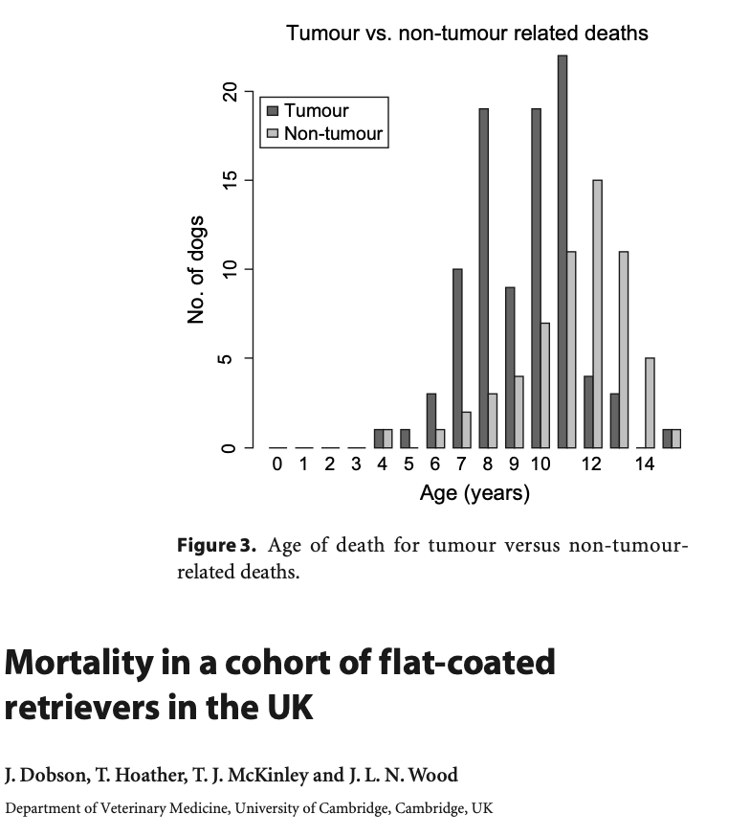
Flat-coated Retrievers
Predisposed to
Progressive Retinal Atrophy
Renal dysplasia
Cancer (50-68% dies of cancer)
Sarcomas
Malignant melanoma
Lymphoma
Histiocytic sarcoma (15-20% develops it)
Notes:
Histiocytic sarcoma uncommon in Golden Retrievers
15-20% of dogs dying of the disease and 50-68%

Slide 2
The Flat-coated Retriever project
In 2011 Uppsala University and the Swedish Flat-coated Retriever Club started a 10 year prospective project to assess and improve the health of Swedish Flat-coated Retrievers
Funded by SKK and Agria
Aim:
A more complete understanding of diseases affecting tge breed in Sweden
Increased understanding of the genetic background of diseases
Gain knowledge and improve the health of the Swedish Flat-coated Retrievers

Slide 3
Histiocytic disease
Rare disease in humans
High prevalence in Flat-coated Retrievers and Bernese Mountain Dogs
Suggest germ-line variants associated with disease development
High mortality rate
Several mutations are associated with the disease
MAPK pathways
BRAF^{V600E} in humans
MAP2K1
PTEN
CDKN2A/B
CDK5RAP2
Notes:
15-20% dies of the disease

Slide 4
Health and disease in Swedish Flat-coated Retrievers
Study 1: Long term study of dogs dogs born in 2012
Blood samples and health information, 10 year surveillance
Study 2: Online death registry
Statistical evaluation of the major causes of death in the population
More detailed information than Agrias database provides
Study 3: Tumor / cancer research
Statistics on the number of tumors diagnosed in the breed, and collection of blood for genetic studies
Collection of genetic material from dogs that have developed cancer in 2012-2014
Notes:
Lack of registering is a common issue for many disease registers.

Slide 5
Study 1: Long term study of dogs dogs born in 2012
Prospective study following of Swedish Flat-coated Retrievers born in 2012 throughout their lives.
Collection of detailed health information, blood samples, and HD radiographs. This information is updated over time.
Register
All diseases
All causes of death
All cancer/tumor cases
Notes:
Dogs are recruited at the age of 1, a blood sample must be taken and the owner fill out an online health survey
They will be contacted for updates on the health of the dog.
Detailed information with disease of various organ systems.

Slide 6
Results so far
Study 1: Long term study of dogs dogs born in 2012
324 blood samples (39.8% of the 2012 population)
274 questionnaries (85% of dogs that have donated blood)
Study 2: Online death registry
Less than 70 registered dogs
Discontinued due to lack of registering
Study 3: Tumor / cancer research
70 samples from individuals with tumors (various types, many benign)
70 controls
Limited phenotypical data
WGS was performed for 21 dogs due to limitations of original studies
Notes:
813 FCR Registered in 2012
Both Serum and EDTA
Unlikely that only 70 out of 7500 dog have died in a 6-year period. Data not representative

Slide 7
WGS of 21 Flat-coated Retrievers
Illumina 30X sequencing | Phenotype | Number
 | Behavior | 8
 | Histiocytic Sarcoma | 6
 | Geriatric Control | 4
 | Cataract | 1
 | Renal Dysplasia | 1
Chromium 30X sequencing
 | Mast cell tumor | 1
 | Healthy young control | 1

Slide 8
WGS of 19 Flat-coated Retrievers
Analyzed with the K9-pipeline developed by NBIS
Coverage: 23.3 (20.9-25.2)
Illumina 30X sequencing | Phenotypes | Number of dogs
 | Behavior | 8
 | Histiocytic Sarcoma | 6
 | Geriatric Control | 4
 | Cataract | 1
 | Renal Dysplasia | 1
Total dogs |  | 19
Notes:
One dog with the behaviour phenotype had cataracts

Slide 9
Control group
160 Swedish dogs
Breeds | Number
Beagle | 20
Cavalier King Charles Spaniel | 20
German Shepherd | 20
Golden Retriever | 20
Labrador Retriever | 20
Standard Poodle | 20
Rottweiler | 20
West Highland White Terrier | 20
Total | 160

Slide 10
Results – F_{st}
Genes with fixed variants
ZBBX
PDE1A
WDR47
NHSL1
RFX4
DPP10 CTU2 SORCS1 RF00026
FST =1
607 SNPs vs the 160 dogs
1580 SNPs vs 20 Golden Retrievers
Going Forward
CNV analysis
Targeted analysis
Know disease
GO analysis

Slide 11
Gencove – Theory
Low-pass sequencing
Imputation of genotypes based on algorithms and their own dataset
Highly accurate variant calls across the genome
Cost efficient to Tumor/normal - maybe
More accurate than genotyping arrays
Notes:
Alg. Til forudsige race, men har dem ikke io ref panel, evt. regionforskelle
Vis steder hvor jeg har snp og de ikke har etc.
T/N: fcr deep cov som tumor og low cov som normal i mutect2.

Slide 12
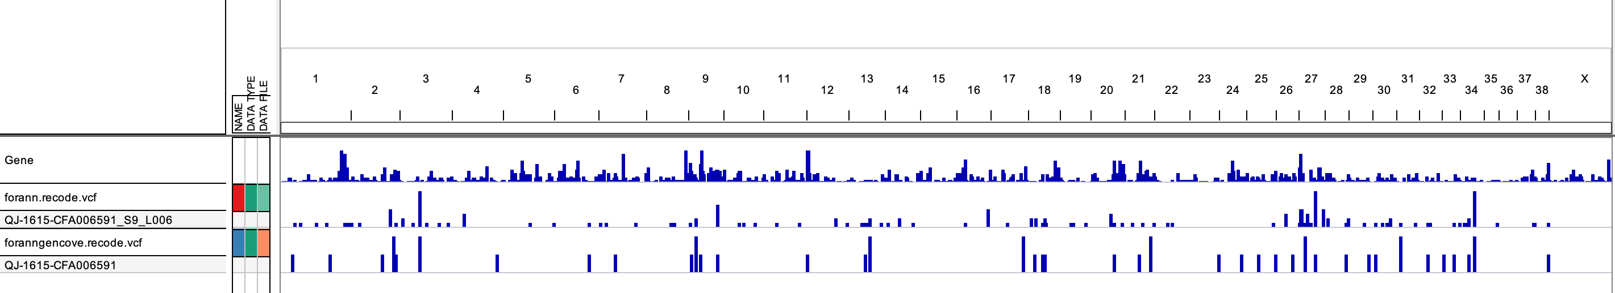
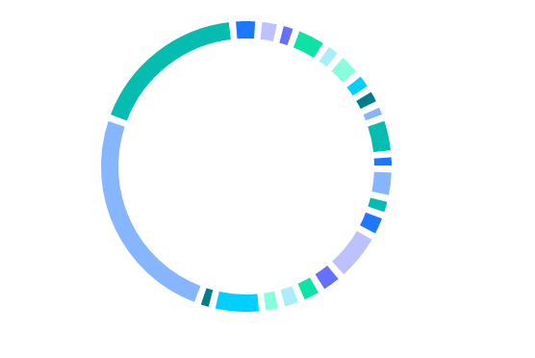



Gencove - Results
Variants are missed compared to high coverage
Ancestry of Flat-coated Retriever
German Shepherd
Notes:
Alg. Til forudsige race, men har dem ikke io ref panel, evt. regionforskelle
Vis steder hvor jeg har snp og de ikke har etc.
T/N: fcr deep cov som tumor og low cov som normal i mutect2.

Slide 13
References
Frequent detection of BRAF^{V600E} mutations in histiocytic and dendritic cell neoplasms, Heounjeong Go et al. 2014
Somatic mutations in histiocytic sarcoma identified by next generation sequencing, Qingqing Liu et al. 2016
The PTEN and INK4A/ARF tumor suppressors maintain myelolymphoid homeostasis and cooperate to constrain histiocytic sarcoma development in humans, Daniel Carrasco et al. 2006
Molecular cytogenetic characterization of canine histiocytic sarcoma: A spontaneous model for human histiocytic cancer identifies deletion of tumor suppressor genes and highlights influence of genetic background on tumor behavior, Benoit Hedan et al. 2011

